Slide 1
Blackjack
Q-Learning
Reinforcement Learning
Group 4: Sherry Xu, Wen Yao, Chelsea Liu, Michelle Peng

Slide 2
Agenda
Basic Case Analysis
Action Space Modification
State Space Expansion
Alternative Methods

Slide 3
Basic Case
Chelsea Liu

Slide 4
Learning Framework Design
Environment Setup:
Blackjack-v1 Environment: Using Gymnasium, implementing Sutton & Barto Blackjack rules
Observation Space: 3-tuple representing player’s current sum, dealer’s face-up card, and usable ace or not
Action Space: Actions hit(1) or stand(0), with rewards: +1(win), -1(loss), 0(draw)
Agent Architecture:
Q-Table Storage: Using defaultdict for dynamic state-action value updates
Exploration Strategy : Epsilon-greedy approach to ensure the balance
Learning Mechanics: Temporal-difference error updates Q-values with discount factor equals to 0.95
Training Process :
Parameter Configuration: Learning rate 0.01 for controlled Q-value convergence
Adaptive Strategy: Epsilon gradually decays over 100k episodes
Progress Visualization: Rolling average applied to provide smooth training visualization

Slide 5
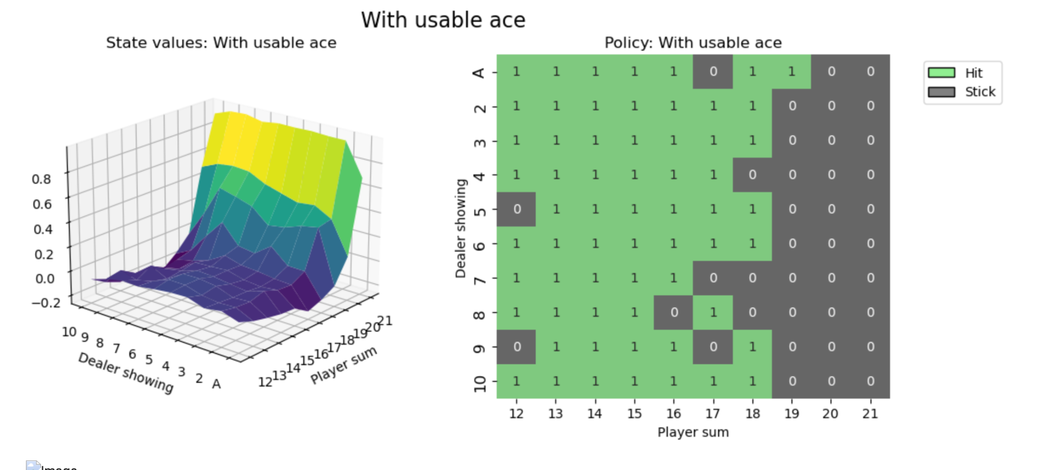
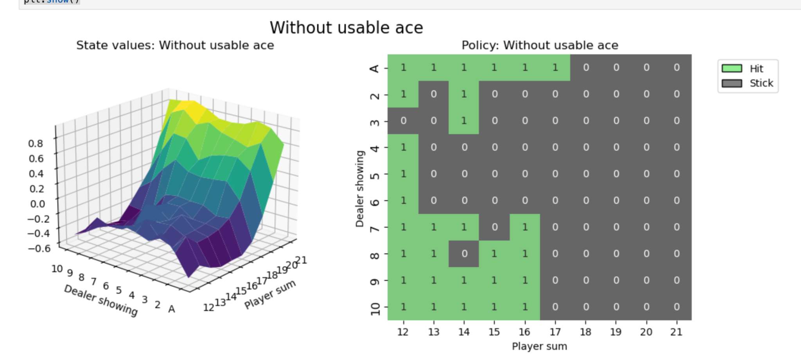
Policy Visualization
Overall, we can conclude that:
Heatmaps align with core Blackjack strategies, validating the agent successfully learned the policy
Higher state value with a usable ace highlight its strategic advantage,
Aggressive hitting with a usable ace, indicating its adaptability to the context and also enabling future comparison

Slide 6
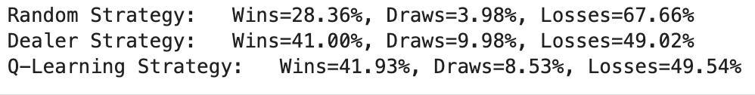
Testing Performance
After training the Q-learning agent, we tested its performance against the random strategy and the dealer's strategy in the built environment:
The Q-learning agent outperforms the random strategy, demonstrating better strategy learned
The winning rate also outperforms dealer’s performance though it has slightly higher losses
Providing an adaptive pathway and benchmark for testing further variations

Slide 7
Variation: Actions Added
Sherry Xu

Slide 8
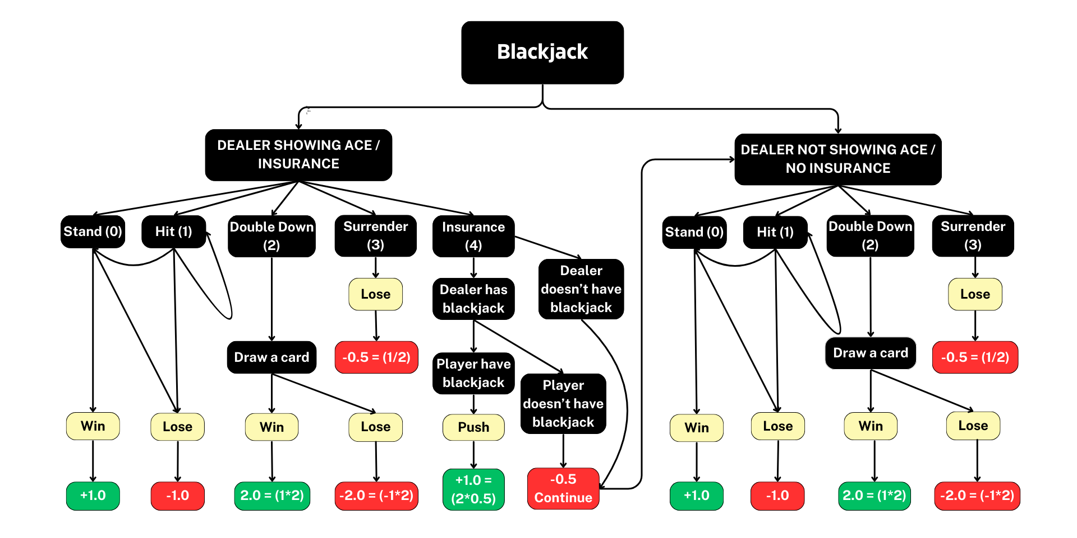
Blackjack’s Actions, Rewards & Environment
Improved based on Open AI’s gymnasium
Create custom blackjack environment (registered)
(1) Natural Blackjack [Ace & 10/J/Q/K] wins player a reward of +1.5; (2) Ace can be used as 1 or 11.

Slide 9
🎰 Welcome to Custom Blackjack!
Insurance
Natural Blackjack
Double Down
🃏 Your Starting Hand: (19, 1, True, 1)
📌 Available actions:
0: Stand
1: Hit
2: Double Down
3: Surrender
4: Insurance
🎯 Select an action: 4
🃏 New Observation: (19, 1, True, 0)
💰 Reward: -0.5
📌 Available actions:
0: Stand
1: Hit
2: Double Down
3: Surrender
🎯 Select an action: 0
🃏 New Observation: (19, 1, True, 1)
💰 Reward: 1.0
🏁 Game Over!
🤵 Dealer's Full Hand: [1, 7] (Total: 18)
🏆 Congratulations, you won!
🃏 Your Starting Hand: (21, 10, True, 0)
📌 Available actions:
0: Stand
1: Hit
2: Double Down
3: Surrender
🎯 Select an action: 0
🃏 New Observation: (21, 10, True, 0)
💰 Reward: 1.5
🏁 Game Over!
🤵 Dealer's Full Hand: [10, 5, 8] (Total: 23)
🏆 Congratulations, you won!
🃏 Your Starting Hand: (10, 2, False, 0)
📌 Available actions:
0: Stand
1: Hit
2: Double Down
3: Surrender
🎯 Select an action: 2
🃏 New Observation: (20, 2, False, 0)
💰 Reward: 2.0
🏁 Game Over!
🤵 Dealer's Full Hand: [2, 10, 6] (Total: 18)
🏆 Congratulations, you won!

Slide 10
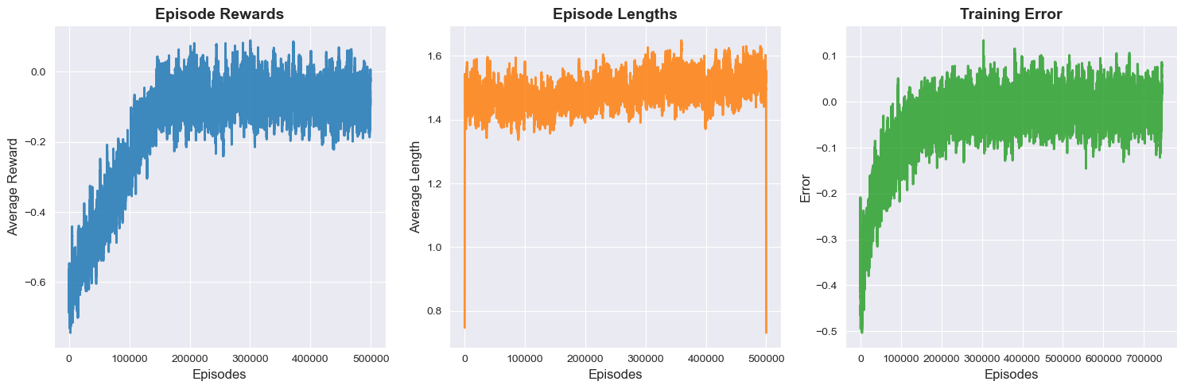
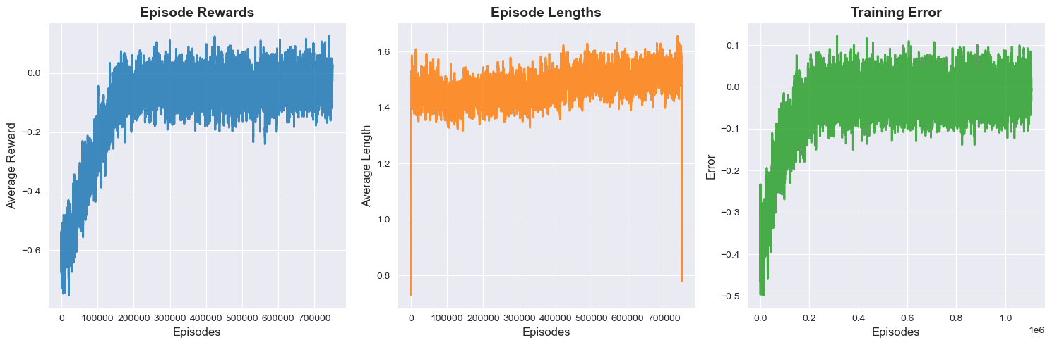
Training the Q-Learning Agent¶
After Hyperparameter Tuning……
More Episodes: 500K → 750K → Better convergence, reduced variance.
Lower Learning Rate: 0.01 → 0.005 → Stable updates, prevents oscillations.
Slower Epsilon Decay: 1.0 / (n_episodes / 3) → 1.0 / (n_episodes / 4.5)
→ Extended exploration, avoids premature convergence.
Lower Final Epsilon: 0.1 → 0.055 → More exploitation in later stages.
Average reward of zero
Average number of actions per episode
Error in Q-value updates

Slide 11
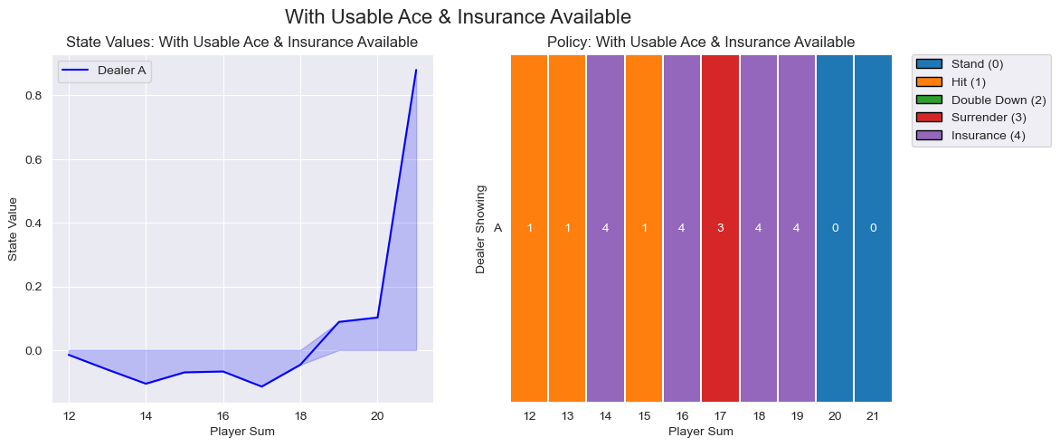
4 Scenarios in Total
State value change sign at 19, indicating a late winning position.
Insurance is preferred for medium-high sums, while surrender is an option at 17.

Slide 12
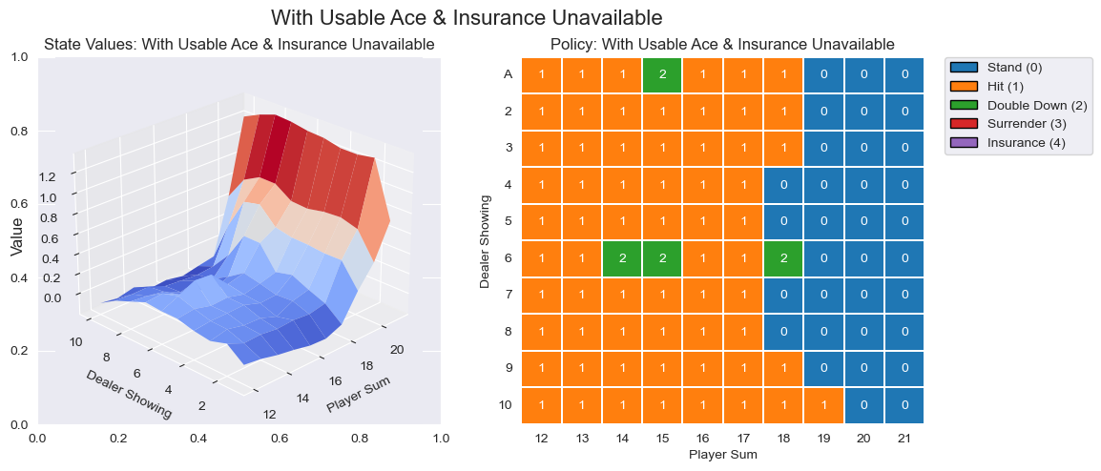
Smooth upward trend, with values increasing near player sum 18+.
Hit is dominant, suggesting an aggressive approach, with occasional double-down.

Slide 13
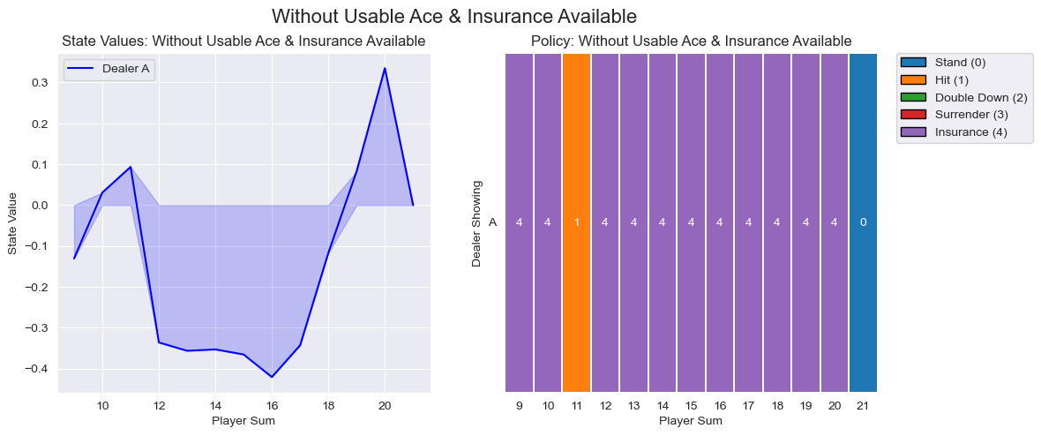
More fluctuation, with a significant dip around 14-16, showing weaker positions.
Insurance is widely selected, except the hit at 11, hoping to risk for a natural blackjack.

Slide 14
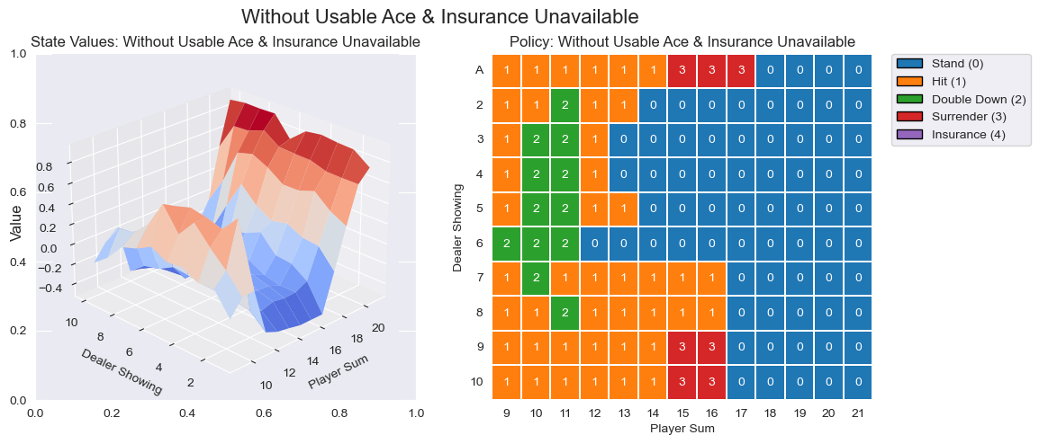
Total Games: 10,000
Wins: 4,197 (41.97%)
Losses: 4,965 (49.65%)
Draws: 838 (8.38%)
Win Rate (Excluding Draws): 45.81%
More variability, with negative values at mid-range sums and a rise at both low (≤10) and high (≥17) sums.
Hit dominates at lower sums, double down is optimal for 10-11, surrender is chosen for weak hands in the middle, and stand is preferred at high sums.

Slide 15
Variation: Expand
State Space
Wen Yao

Slide 16
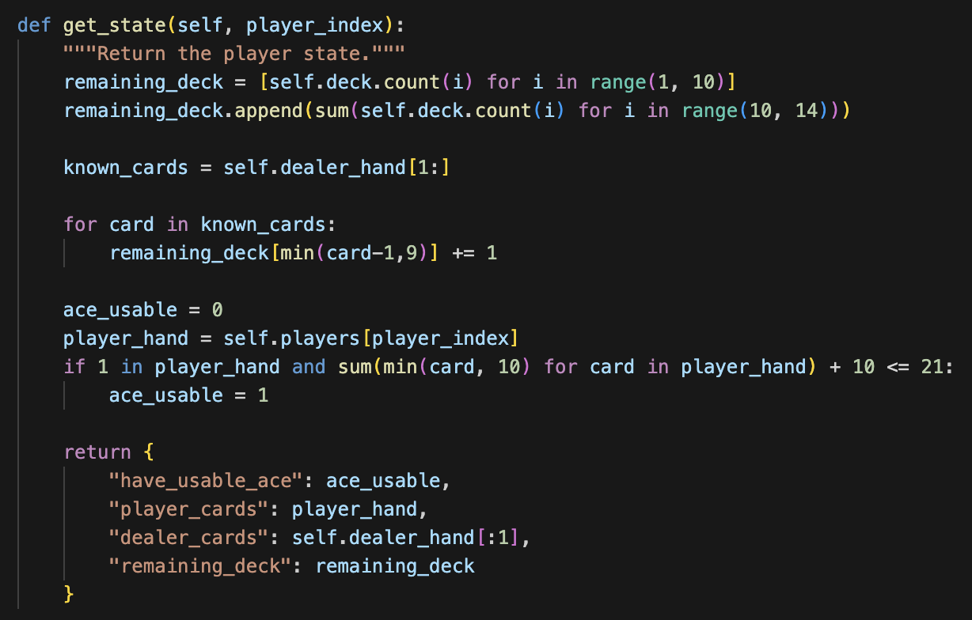
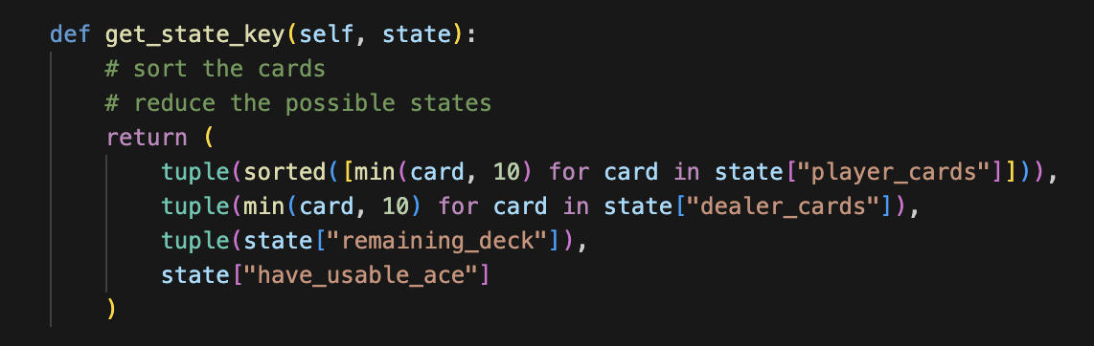
Environment Introduction
Previous state space only includes
((player_hand),(dealer’s first card), (usable_ace_note))
But if the deck is limited (if we only use one or two deck), the remaining deck will influence the probability in the card agent gets if it chooses to hit. So we decide add the remaining_deck in the state space.
((player_hand),(dealer’s first card), (usable_ace_note),
(remaining_deck))
We also take some methods to reduce the state space:
When calculating the remaining_deck, we count 10, J, Q, K together
In Q-learning process, we will sort the player’s card and transform the 10, J, Q, K card in player/dealer’s hand to 10.

Slide 17
Environment Introduction
With the new state space, we are able to train Q-learning agent in more environment:
Add more player in the same game
Keep playing for several round before reset the cards
Create agent for each agent
Use the same agent
1. One Player (Basic)
2. Multiple players with multiple agents
3. Multiple players with same agent
4. Keep playing
To simplify the training, we only use ONE deck.
In 2 & 3, we will set 3 players. In 4, we will reset the deck if we have kept playing for 5 rounds or the number of remaining cards is less than 30.

Slide 18
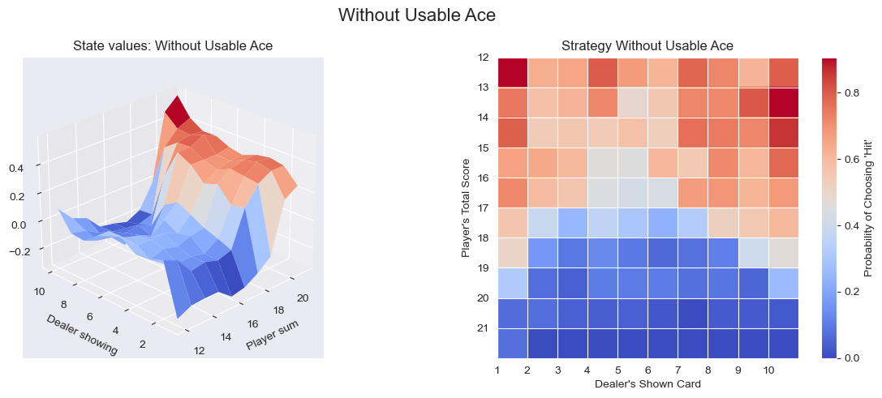
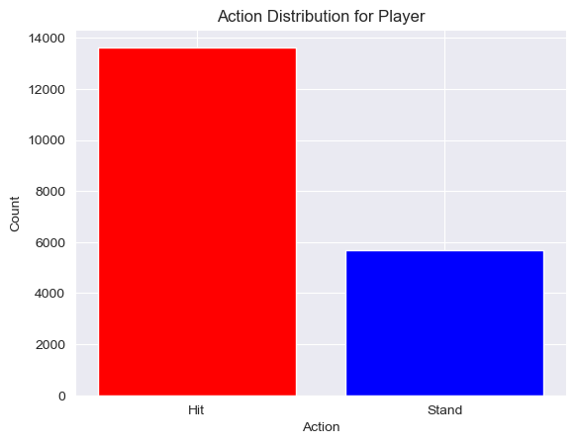
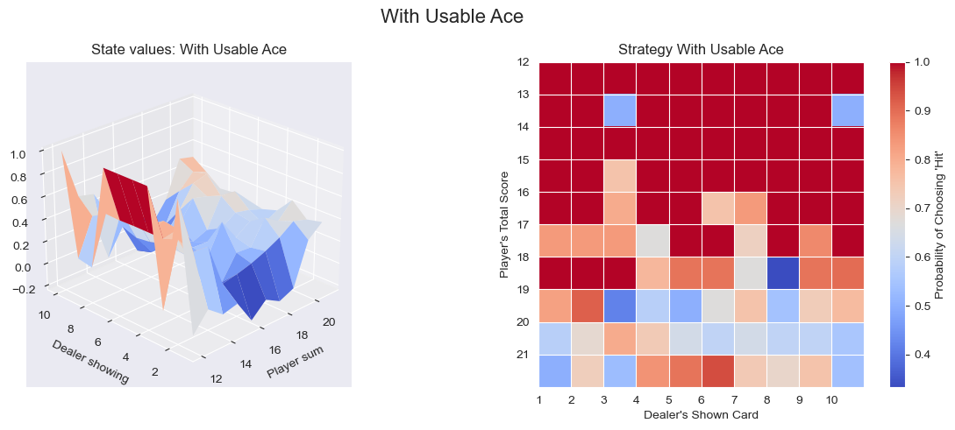
One Player (Basic)
1 player, 1 deck
Train for 500,000 rounds
Strategy | Win rate | Draw rate | Loss rate
Random | 29.70% | 2.80% | 67.50%
Dealer | 39.50% | 8.90% | 51.60%
Q-learning | 40.50% | 6.70% | 52.80%
Single player
Action Distribution:
Hit: 70.55%
Stand: 29.45%
Q-table size: 19,323

Slide 19
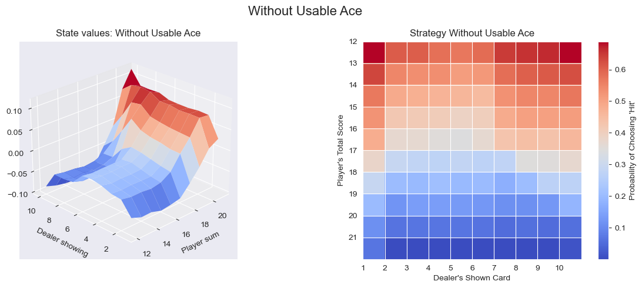
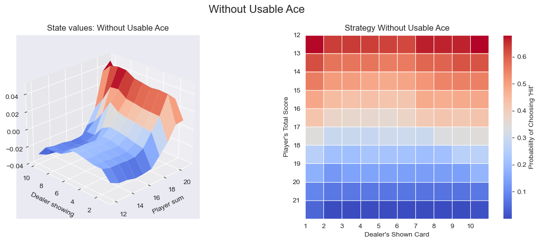
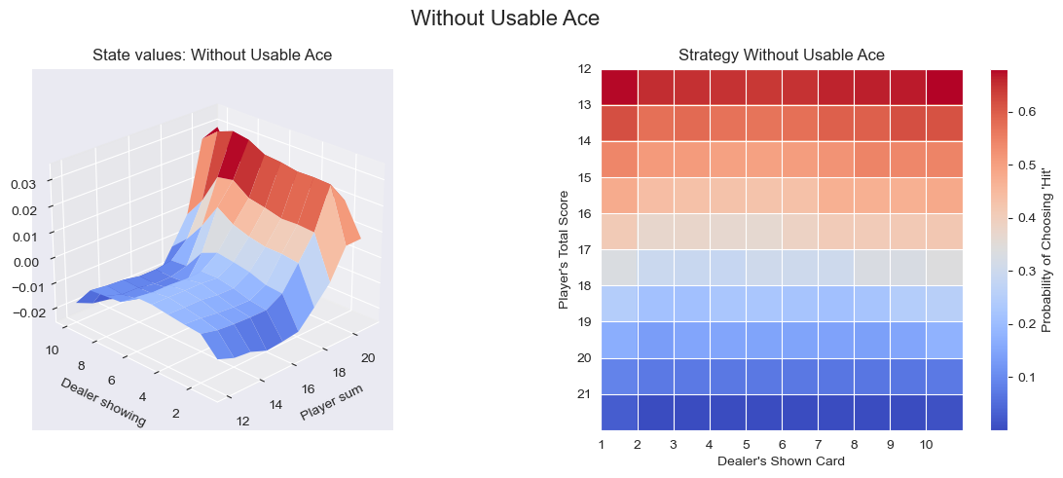
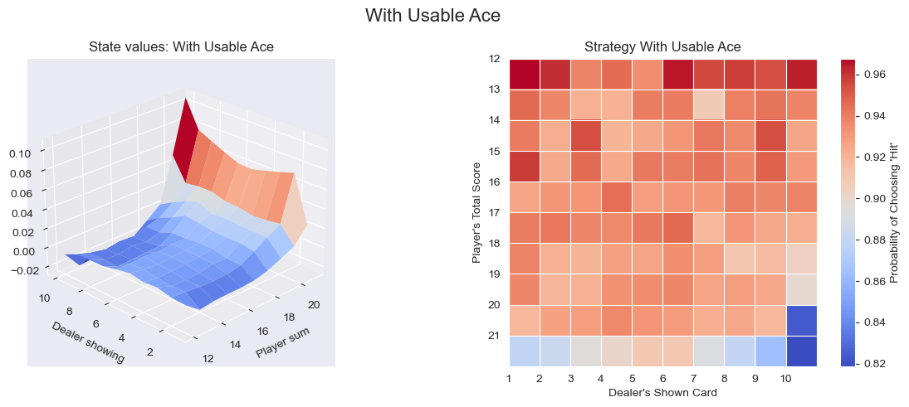
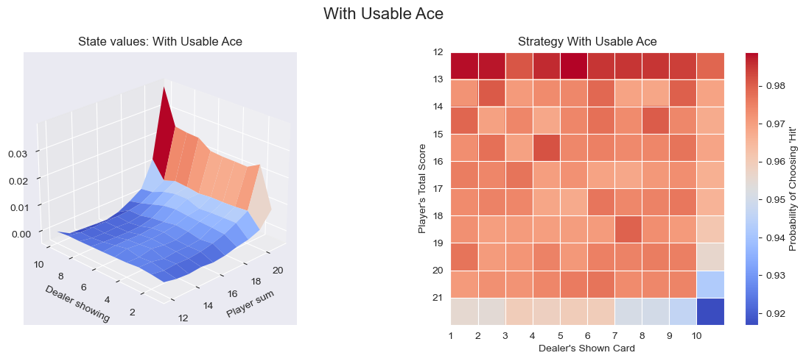
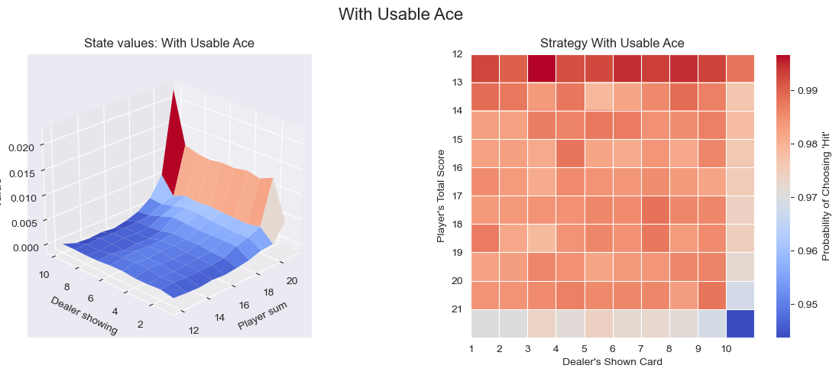
2. Multiple players with multiple agents
3 players, 1 deck
Train for 5,000,000 rounds
Create agent for each player
Player 1
Player 2
Player 3
Q-table size: 1,413,306
Q-table size: 3,509,873
Q-table size: 4,864,844

Slide 20
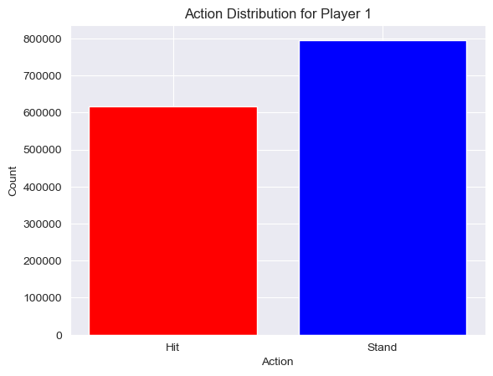
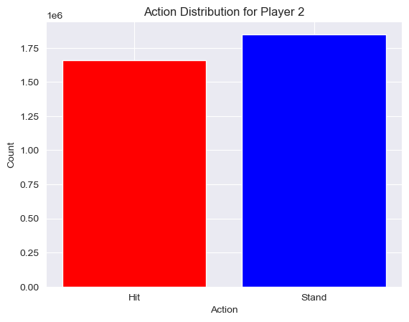

Player 1
Hit: 43.70%
Stand: 56.30%
Player 2
Hit: 47.29%
Stand: 52.71%
Player 3
Hit: 47.96%
Stand: 52.04%
Player | Win rate | Draw rate | Loss rate | Q-table size
1 | 40.20% | 7.20% | 52.60% | 1413306
2 | 37.90% | 5.70% | 56.40% | 3509873
3 | 35.40% | 5.60% | 59.00% | 4864844
To conclude, three agents both have over 40% not to lose a game.
We observed that player 1 has the smallest state space and highest win rate. And there are also some minor differences in action distribution, like player 1 has the lowest hit rate, while player 3 has the highest hit rate.

Slide 21
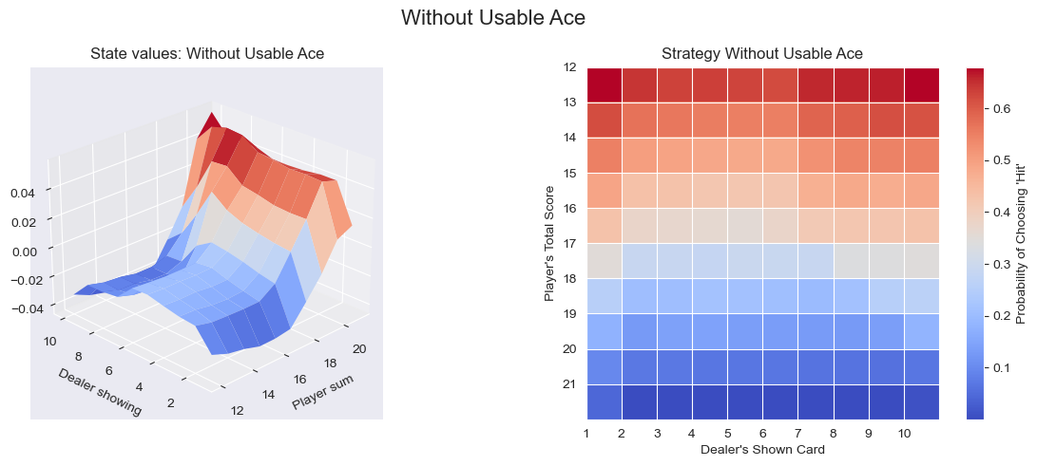
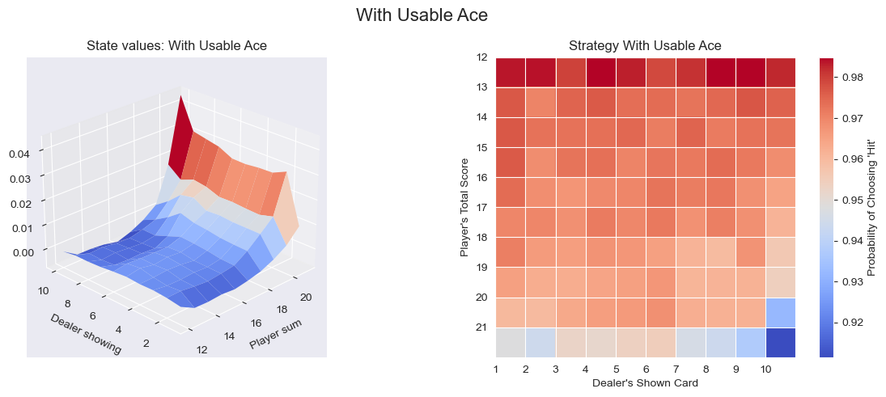
3. Multiple players with same agent
3 players, 1 deck
Train for 5,000,000 rounds
Create only ONE agent
3 player, 1 deck
Player | Win rate | Draw rate | Loss rate
1 | 38.90% | 6.90% | 54.20%
2 | 35.20% | 8.60% | 56.20%
3 | 32.50% | 6.30% | 61.20%
Action Distribution:
Hit: 46.88%
Stand: 53.12%
We can see the win rate of this agent for each player is a bit lower than the separate agents (in 3).
The Q-tables for the three separate agents contains 9,788,023 states in sum, which is approximate with the Q-table size in this agent.
Q-table size: 7,678,327

Slide 22
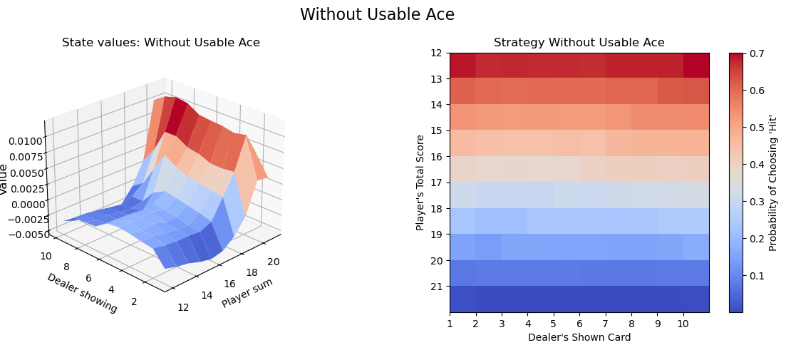
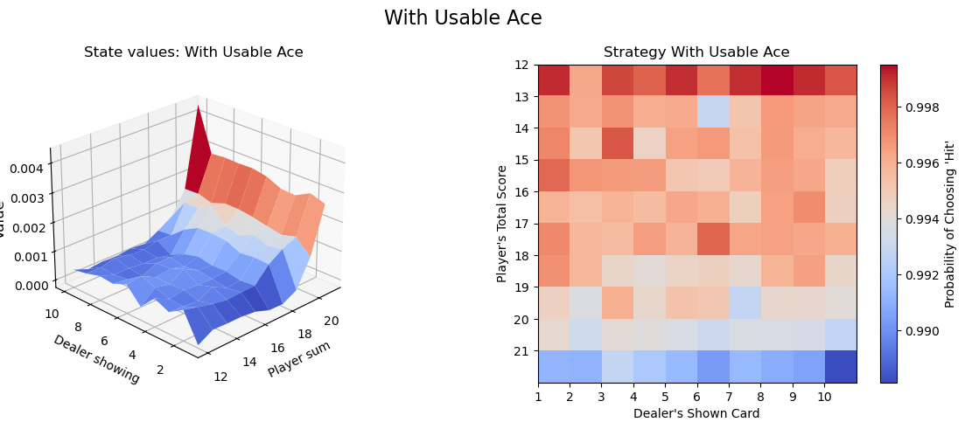
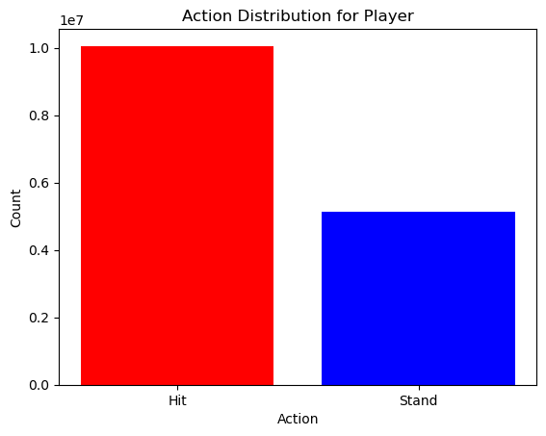
4. Keep playing
1players, 1 deck
Train for 8,000,000 rounds
Keep playing for 5 rounds
Strategy | Win rate | Draw rate | Loss rate
Random | 31.80% | 4.00% | 64.20%
Dealer | 39.60% | 8.50% | 51.90%
Q-learning | 36.00% | 5.80% | 58.20%
5 round, 1 deck
Action Distribution:
Hit: 66.23%
Stand: 33.77%
Q-table size: 15,175,900

Slide 23
Variation: Other Methods
Michelle Peng

Slide 24
Monte Carlo Method
Collecting Random Episodes
Get Expected Reward
Estimate Q-values using MC
Optimal Policy
01
02
03
04

Slide 25
Process of Monte Carlo Methods
For each episode:
Generate an episode by choosing an initial action randomly
Store (state, action) pairs for first-visit check (impossible to have the same state appearing more than once in Blackjack episode)
While not done:
Step forward in the game to get new state, reward and game status
Select next action based on epsilon-greedy policy (With probability ε, select a random action (exploration); otherwise, select the action with the highest Q-value (exploitation).)
Store (state, action, reward) and update state to next state
Reverse the episode and calculate returns from last to first state
Accumulate G = discount_factor * G + reward at each step
Check if first visit to (state, action):
Update Q(action value) using incremental mean
Update V(state value) using incremental mean
Update Policy using the max-Q action

Slide 26
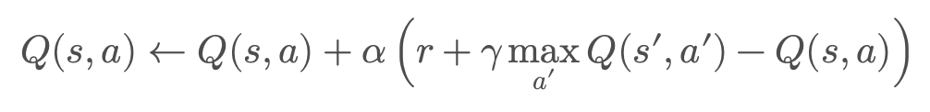
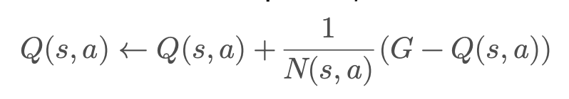
Major differences between Q-learning and Monte Carlo
Feature | Q-Learning | Monte Carlo
Update Style | Bootstrapping | Full Episode-Based Learning
When is Q updated? | After each step | At the end of an episode
How is Q updated? | Bellman Equation | Using actual full episode returns
Exploration | ε-greedy | Exploring Starts, ε-greedy
Works in Non-Episodic Tasks? | Yes | No
Convergence Speed | Faster (updates per step) | Slower (waits for full episode)
Stability | More prone to bias | Unbiased but slower
Best Used For | Continuous tasks (e.g., trading, robotics) | Episodic tasks (e.g., Blackjack, Chess)

Slide 27
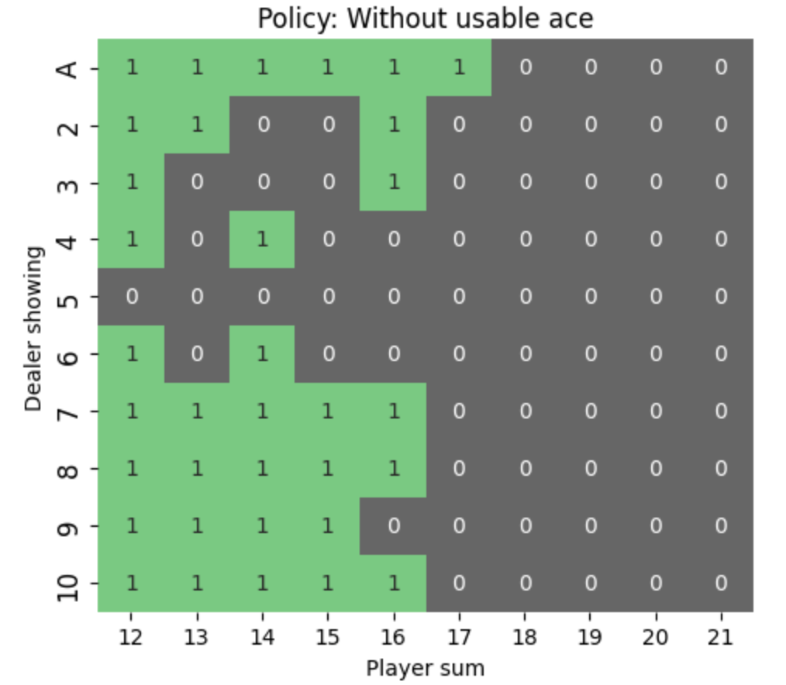
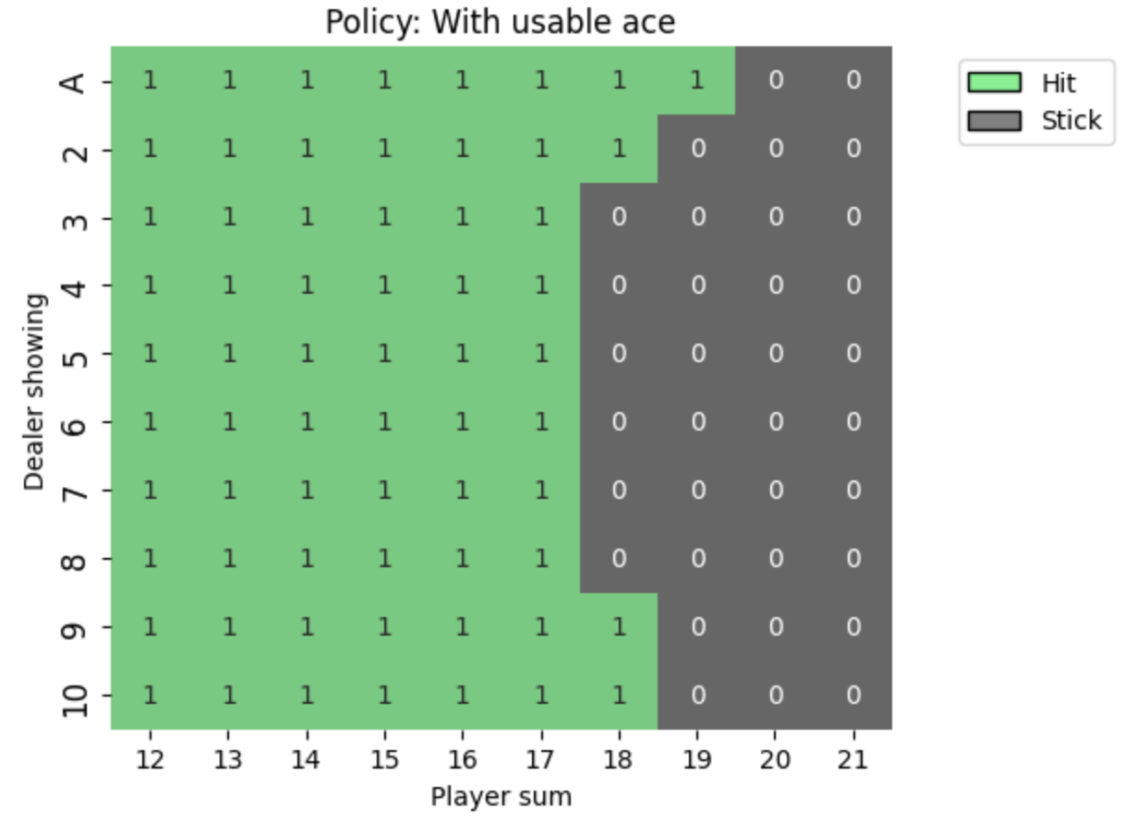
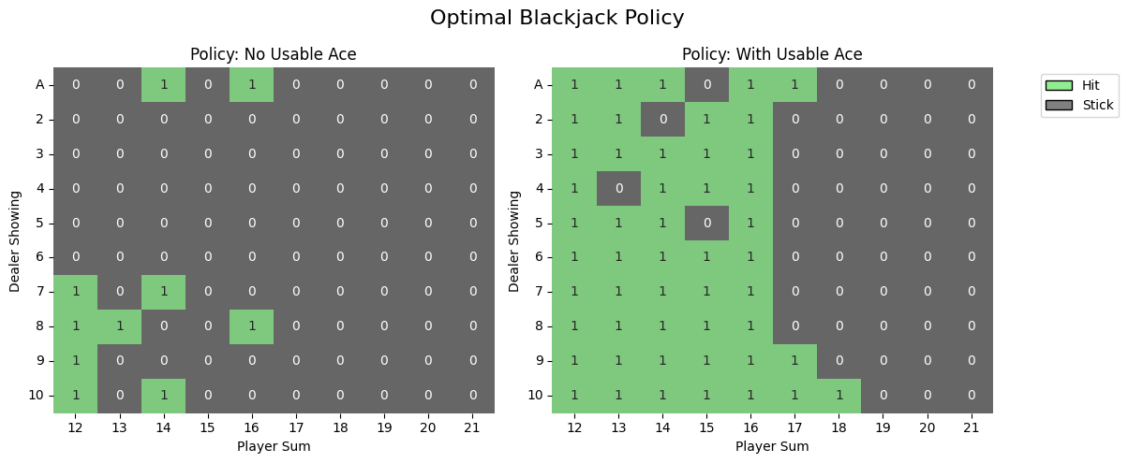
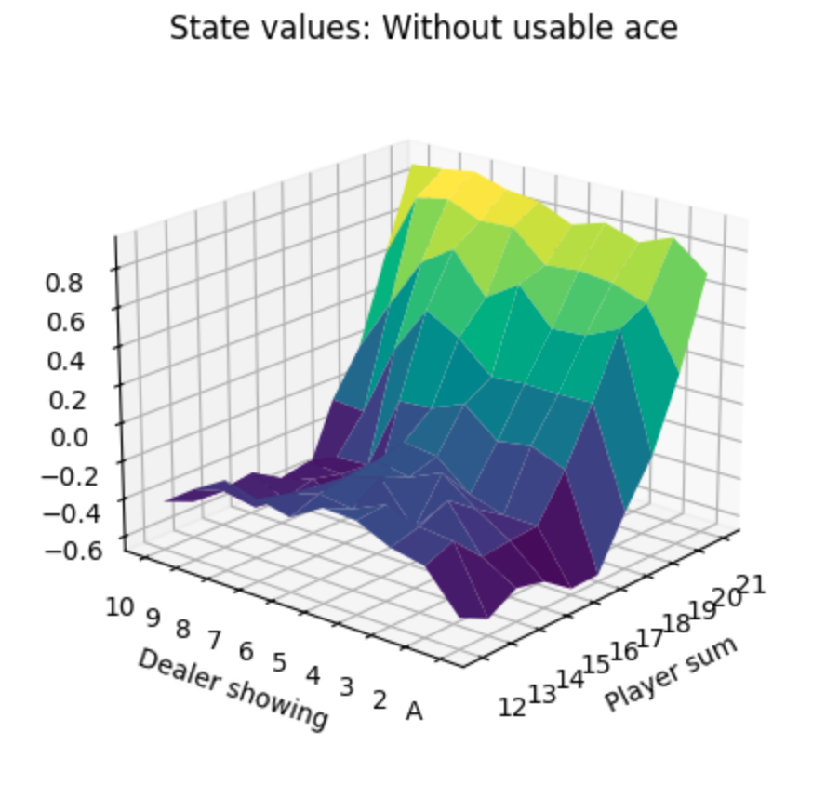
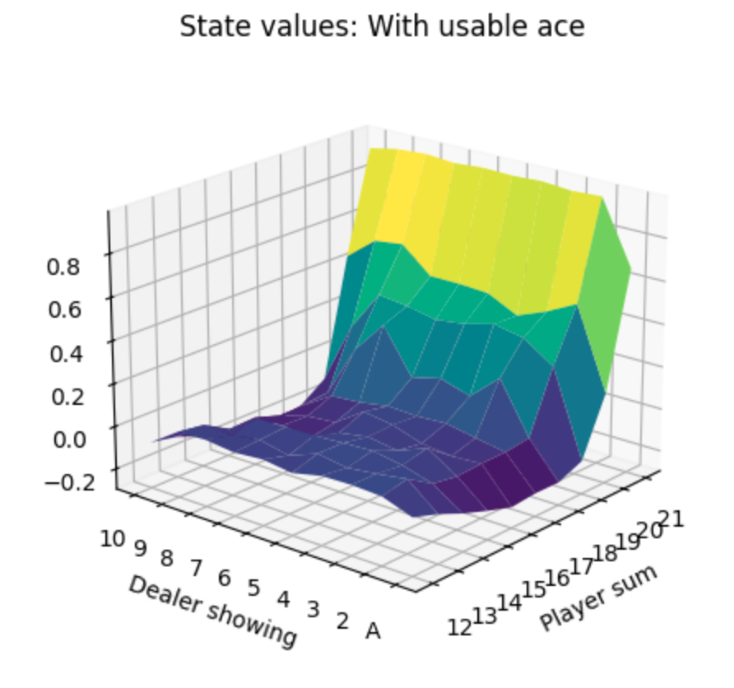
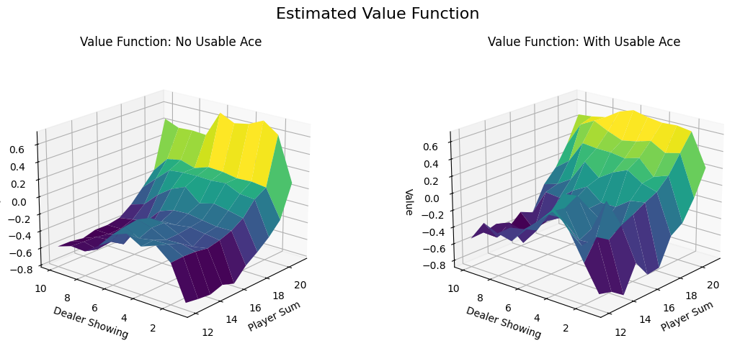
Result Comparison Between Q-learning and Monte Carlo
Q-learning
Monte Carlo

Slide 28
Thanks

